Slide 1

TOEFL SPEAKING
LYNN WU

Slide 2

吴悠 Lynn
新航道 北美考试院 托福口语
Sheffield Hallam University
心理学 （临床/教育/犯罪）

Slide 3
CLASS RULES
01
02
03
Take notes
Participate
Mock exams
Practice
app 小站托福 考满分

Slide 4
AGENDA
FINISH
3. Task 1题型
难点解析
1. 口语题型
5. Task 1人物类
答题技巧
4. Task 1人物类
答题思路
2. 评分标准
托福新政

Slide 5
PART 1
新托福口语 题型

Slide 6
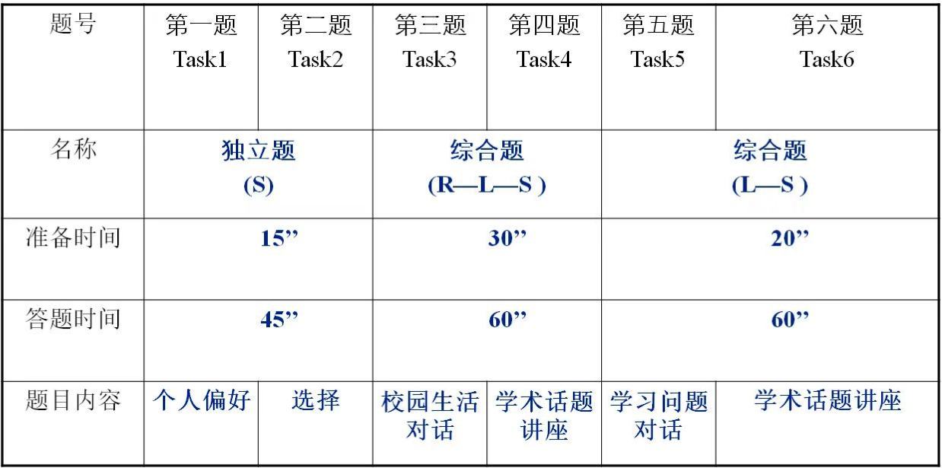
口语题型

Slide 7
PART 2
评分标准 & 托福新政

Slide 8
评分标准 --- 3个维度
Delivery
Language Use
Topic Development
Fluency
Pronounciation
Intonation
Pacing
Logic
Coherent
Sustained
Grammar
Vocabulary
Sentence structure

Slide 9
评分标准 --- Match Point 23分大关
Scaled Speaking Score
4.00 30
3.83 29
3.66 28
3.50 27
3.33 26
3.16 24
3.00 23
2.83 22
2.66 20
2.50 19
2.33 18
2.16 17
2.00 15
1.83 14
1.66 13
1.50 11
1.33 10
1.16 9
1.00 8
— 0-6
Scoring Rubrics
4 GOOD （3.33+）
3 FAIR （2.33+）
2 LIMITED （1.33+）
1 WEAK

Slide 10
评分标准 4 Good
Delivery
Language Use
Topic Development
Generally well-paced flow (fluid expression). Speech is clear. It may include minor lapses, or minor difficulties with pronunciation or intonation patterns, which do not affect overall intelligibility
The response demonstrates effective use of grammar and vocabulary. It exhibits a fairly high degree of automaticity with good control of basic and complex structures (as appropriate). Some minor (or systematic) errors are noticeable but do not obscure meaning.
Response is sustained and sufficient to the task. It is generally well developed and coherent; relationships between ideas are clear (or clear progression of ideas).

Slide 11
评分标准 2 Limited
Delivery
Language Use
Topic Development
Speech is basically intelligible, though listener effort is needed because of unclear articulation, awkward intonation, or choppy rhythm/pace; meaning may be obscured in places.
The response demonstrates limited range and control of grammar and vocabulary. These limitations often prevent full expression of ideas. For the most part, only basic sentence structures are used successfully and spoken with fluidity. Structures and vocabulary may express mainly simple (short) and/or general propositions, with simple or unclear connections made among them (serial listing, conjunction, juxtaposition).
The response is connected to the task, though the number of ideas presented or the development of ideas is limited. Mostly basic ideas are expressed with limited elaboration (details and support). At times relevant substance may be vaguely expressed or repetitious. Connections of ideas may be unclear.

Slide 12
Score | Delivery | Language Use | Topic Development
4 Good | Generally well-paced flow (fluid expression). Speech is clear. It may include minor lapses, or minor difficulties with pronunciation or intonation patterns, which do not affect overall intelligibility | The response demonstrates effective use of grammar and vocabulary. It exhibits a fairly high degree of automaticity with good control of basic and complex structures (as appropriate). Some minor (or systematic) errors are noticeable but do not obscure meaning. | Response is sustained and sufficient to the task. It is generally well developed and coherent; relationships between ideas are clear (or clear progression of ideas).
3 Fair | Speech is generally clear, with some fluidity of expression, though minor difficulties with pronunciation, intonation, or pacing are noticeable and may require listener effort at times (though overall intelligibility is not significantly affected). | The response demonstrates fairly automatic and effective use of grammar and vocabulary, and fairly coherent expression of relevant ideas. Response may exhibit some imprecise or inaccurate use of vocabulary or grammatical structures or be somewhat limited in the range of structures used. This may affect overall fluency, but it does not seriously interfere with the communication of the message. | Response is mostly coherent and sustained and conveys relevant ideas/information. Overall development is somewhat limited, usually lacks elaboration or specificity. Relationships between ideas may at times not be immediately clear.
2 Limited | Speech is basically intelligible, though listener effort is needed because of unclear articulation, awkward intonation, or choppy rhythm/pace; meaning may be obscured in places. | The response demonstrates limited range and control of grammar and vocabulary. These limitations often prevent full expression of ideas. For the most part, only basic sentence structures are used successfully and spoken with fluidity. Structures and vocabulary may express mainly simple (short) and/or general propositions, with simple or unclear connections made among them (serial listing, conjunction, juxtaposition). | The response is connected to the task, though the number of ideas presented or the development of ideas is limited. Mostly basic ideas are expressed with limited elaboration (details and support). At times relevant substance may be vaguely expressed or repetitious. Connections of ideas may be unclear.
1 Weak | Consistent pronunciation, stress and intonation difficulties cause considerable listener effort; delivery is choppy, fragmented, or telegraphic; frequent pauses and hesitations. | Range and control of grammar and vocabulary severely limit or prevent expression of ideas and connections among ideas. Some low-level responses may rely heavily on practiced or formulaic expressions. | Limited relevant content is expressed. The response generally lacks substance beyond expression of very basic ideas. Speaker may be unable to sustain speech to complete the task and may rely heavily on repetition of the prompt.

Slide 13
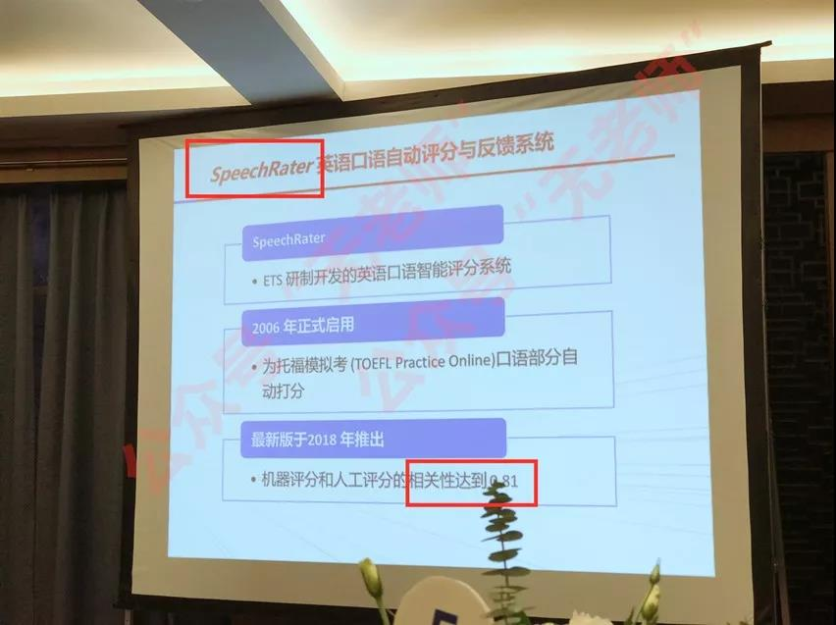
托福口语新政 --- 考生的嘴，骗人的鬼？
SpeechRater 上线
Delivery & Language Use
影响因子 TOP 3
Mean Silence Duration
Highest Word CVA Similarity Score
Speaking rate in Words per Second

Slide 14
PART 3
TASK 1 题型 & 痛点

Slide 15
Practice Time
TASK 1 有几种题型？

Slide 16
TASK 1 题型
1
PEOPLE & RELATIONSHIP
2
STUDY & JOB
3
LIFE EXPERIENCE & ACTIVITIES
TECHNOLOGY & SOCIETY
4

Slide 17
Do you agree or disagree with the following statement?
It is more important to maintain relationship with family members than with friends.
2016.03.11
Prep time: 15s
Answer time: 45s
Practice Time

Slide 18

TASK 1 痛点 --- 中国考生的“恐怖游轮”
开不了口？ 没话讲？
开口即扣分？
衔接生硬
万能语料
骗过机器的
Delivery &Language Use
万能句& 替换词汇

Slide 19
PART 4
TASK 1 人物题 & 答题思路

Slide 20
Practice Time
人物题有几种题型？

Slide 21
TASK 1 题型
1
FAMILY & FRIENDS
2
ROLES & CHARACTERS
3
THE ELDERLY
INTERPERSONAL RELATIONSHIPS
4
5
PARENTAGE

Slide 22
PART 5
TASK 1 人物题 答题技巧

Slide 23
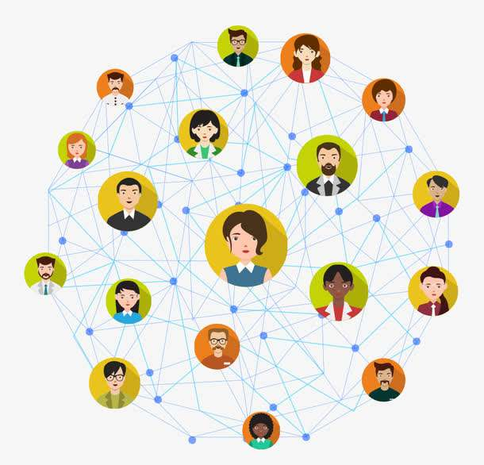
INTERPERSONAL RELATIONSHIPS 人际关系题
45

Slide 24
INTERPERSONAL RELATIONSHIPS 1
45
Friends may disagree with each other, and still maintain friendship. Do you agree or disagree with this idea and why. Please include specific examples and details in your explanation.
2017.01.07 Task2
Preparation time: 15s
Answer time: 45s

Slide 25
人际关系题 万能语料
友谊的重要性
We have a tight/ secure/ close/ attached friendship, it is like a natural bond, we are never apart/are like conjoined twins.（关系紧密）
… is a caring/ compassionate/ empathetic person, is always there for me ( to reach out/ to give a helping hand )when I’m down/ under the weather/ not feeling so good/ upset. (关心我）
… is very considerate, understand me/know me the most/best. Great minds think alike. (理解我）
True/ genuine relationship is very rare/ hard to find/ obtain; It will be (such) a shame/ pity/ tragedy to lose/ fail a relationship based on/ just because of a disagreement/ dispute .（友情的难得）

Slide 26
人际关系题 万能语料
Respect the difference 尊重个人差异
People may have different opinion/POV/ concept/mindset/ moral standard towards certain things.（三观不同）
...were brought/ grow up in different upbringings/ family, no need to judge/ convert others；don’t know what … has been though . (成长环境不同）
It is an universal/ widely known fact/ truth that disagreement exists in every relationship, can agree and disagree, no hard feelings. (争议的普遍性)

Slide 27
人际关系题 有论点，没论据？？？
举个例
摆事实
再不济? 上对比！
“假亦真时真亦假”

Slide 28
人际关系题 万能句型
开头引入
I definitely/ absolutely/ wholeheartedly think … is a great idea / very important
for ... to ...
When talking/ discussing about..., the very first coming to my mind is ...
论点引入
As for why, I suppose/ guess/ think that’s mainly because…
Firstly, well first and foremost/ the first reason would be ...
论据引入
As for why/ how/ the reason, I suppose that’s mainly/ mostly because…
Let me take sb. / sth. as an example/ for instance
As for me, I literally/ once do/ did sth.
对比引入
However, … is a totally different situation.
But when it comes to ..., it is completely another scenerio.

Slide 29
INTERPERSONAL RELATIONSHIP 万能语料有多万能？？？
45
When you have some disagreements with your friends and family members, will you choose to convince them or respect the difference?
2018.01.03 Task2

Slide 30
INTERPERSONAL RELATIONSHIPS 2
45
Do you agree or disagree with the statement: People should be honest and open to close friend.
2018.07.01 Task2
Preparation time: 15s
Answer time: 45s

Slide 31
Agree
Close friends are called close for a reason:
---- share our secret/ give me feedback and constructive advices/ even save my life in in extreme case;
----- feel safe around them, always exchange our POV when we are together/ better bonding/ friendshup enhancer

Slide 32
Disagree
Everyone has secret that needs to be held back ( 对自己）
skeleton in the closet/ white lie/ can’t hurt a bee
Don’t wanna give pressure to others about sharing secrets（对他人）
embarrassing / humiliated/self- deprecating stories; put pressure on/ stress on

Slide 33
INTERPERSONAL RELATIONSHIPS 3
45
Some people believe that we should not discuss about the private activities of the popular people, like movie stars and singer. Do you agree or disagree? Please include specific examples and details in your explanation.
2017. 09.24 Task2
Preparation time: 15s
Answer time: 45s

Slide 34
Agree
Should give privacy/ respect the private life of celebrities
---- hoax/papparazzi/ personal information leak/demeaning photos and videos
things we read/heard might not be true
--- fake death news/forged signature/spreading rumors/ challenging for celebrity to build further career/ bad rep or public figure

Slide 35
Disagree
Free speech
people are allowed to discuss whatever they wish to talk about
Gossiping about celebrity is a way to relieve stress
Scandals have bad influence on minors, should talk about it and to further avoid it/ supporting the same artist
blackmailing/ sexual harassment/ drug abuse

Slide 36

Parentage 家庭教育题
45

Slide 37
PARENTAGE 1
45
Do you agree or disagree with the statement? Parents should be a part of children’s decision making process. Explain why.
2014.12.12 Task2
Preparation time: 15s
Answer time: 45s

Slide 38
Agree
there is a part of the responsibility coming with being a parent.
When a child is making the right decision…
encourage/promote similar behaviors;
give positive reinforcement such as prize;
learn from the goods
When making bad decisions…
some decisions can be dangerous/harmful ; illegal and unethical behaviors
should step in and prohibit such behavior such as drug dealing, smoking.

Slide 39
Disagree
Bad parenting exists （不良教育）
e.g. Phillipine drug dealing parents in extreme poverty
children end up uneducated, life-long sentence in correctional center
e.g. Force-feeding in China
obesity in children, diabetes and etc.
Forced will on children( 强加意愿）
Parents failed to achieve a goal; tragic childhood; mental illnesses such as depression/ anxiety/ schizophrenia.

Slide 40
PARENTAGE 2
45
Some people prevent their children from make mistakes, while others allow kids to do so. Which type of parent do you think is better?
2018. 03.11 Task2
Preparation time: 15s
Answer time: 45s

Slide 41
PARENTAGE 3
45
Children need to learn to cooperate and get along with others when they grow up. Please give examples of how adults can help them acquire those skills.
2017.10.14 Task2
Preparation time: 15s
Answer time: 45s

Slide 42
TASK 1 建议类话题 答题思路
15
金钱
financial support, save up funds, purchase related equipment or materials
时间
companionship, bits and pieces of time, time management skills
知识
be educated, have sufficient trainings, follow a mentor, …

Slide 43
In order to coorperate…
Spending time with kids (时间上）
(play games about team spirit, how to be a team player)
Invest in trainings, early development programs （经济上）
(purchase educational books， go to boarding school to receive first-class mentoring programs provided by leading psychologists/ doctors)
To read, to play-and-learn(学习中）
“All work and no play makes Jack a dull boy.”
immersive learning environment; set up playmates, play board games.

Slide 44
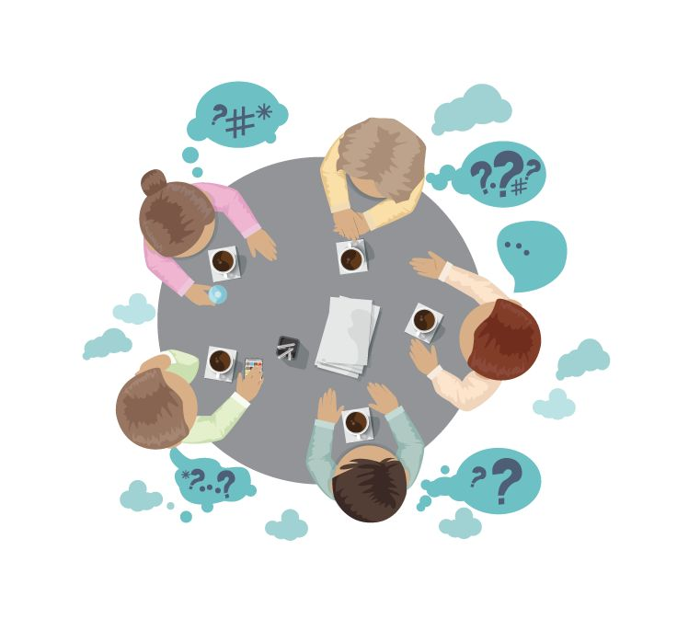
Roles & Characters 性格特质题
45

Slide 45
ROLES & CHARACTERS 1
45
Someone prefer to be the team leaders while others prefer to be the team players. Which one do you prefer to be and why? Please include specific examples and details in your explanation.
2016.01.07 Task2
Preparation time: 15s
Answer time: 45s

Slide 46
特质性格题 万能语料
Great leadership skills; father/mentor figure 有领导特质
...has strong willpower/quality of perseverance/fortitude/ is determined.（意志力强）
… is very optimistic/ motivated/ passionate/ inspirational . (充满正能量）
Quality of Integrity/ is honest/genuine/ trustworthy; is fair to others. (诚信与公正）

Slide 47
特质性格题 万能语料
Have great/advanced communication skills 社交能力强
… is a chill/laid back/easy going person; is hardly irritated/ rarely get mad（性格随和）
… is outgoing/ an extrovert; get along with anyone within minutes, is very sociable; (外向/自来熟）

Slide 48
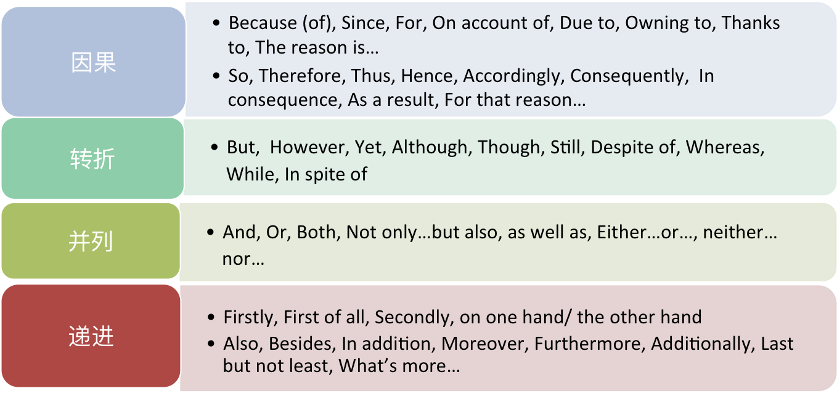
万能词汇

Slide 49
ROLES & CHARACTERS 2 万能语料有多万能？？？
45
Do you agree or disagree with the following statement? If you want to be successful in running a business, being outgoing and friendly is very important.
2018.08.21 Task2
Preparation time: 15s
Answer time: 45s

Slide 50
TASK 1 否定思路 切入点
15
相比之下，不是最好 --------- 进而阐述其他论据的优越之处
为何不好？ -------- being friendly and outgoing 所带来的坏影响 (可扩大，可夸张化）

Slide 51

Pro
People who have an outgoing personality are more sociable
Successful/ huge business needs a giant social network
Queen bee/easy to communicate/ negotiate, easier to seal the deal
Acquaintances; let’s take xxx as an example

Slide 52
Pro
A friendly person makes you feel trusted and comfortable
Businessmen are prone to do business with trusted partners
Bring good vibes to the meeting/ feeling relaxed and chilled
Avoid failure of potential deal/ the last thing they want to see is …

Slide 53

Con
Leadership skill is dynamic, which means being trustworthy is more vital

Slide 54
Con
Being overly-friendly can do harms
the act can be suspicious/ fishy/ skeptical
Business partners may question your true aim behind the act
FAKE VS. Authentic/ genuine/ real

Slide 55
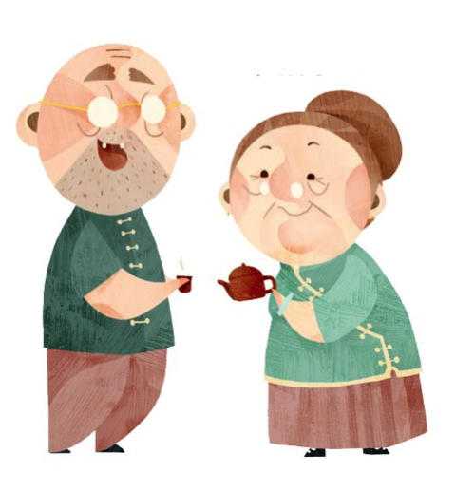
The Elderly 老龄问题
45

Slide 56
The Elderly 1
45
Some people believe that old people should not take risk and participate adventurous events as the young people. Do you agree？ Why?
2017.09.23 Task2
Preparation time: 15s
Answer time: 45s

Slide 57
TASK 1 万能答题思路
15
Topic
Perspective 1 （对自己）
Perspective 2 （对他人）
Perspective 3 （对双方）
Conclusion

Slide 58
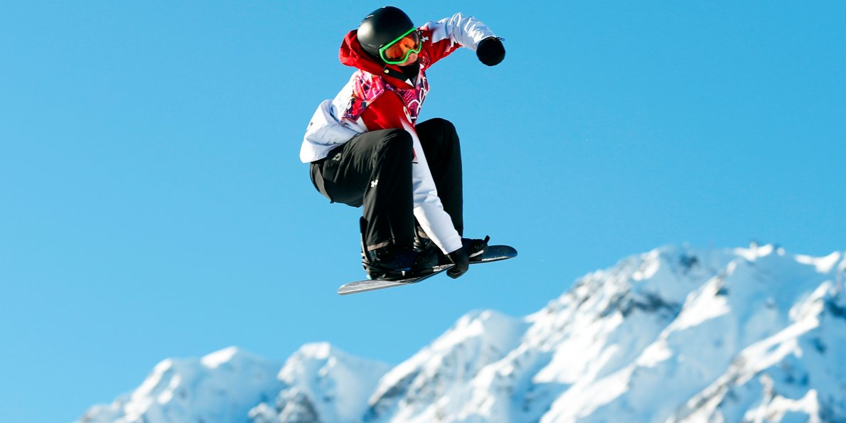
Agree
High risk events can be dangerous, elderly will hurt themselves. (对自己）
Extreme sports such as parkour/snowboarding/ sky-diving/ highlining …
Higher risk of hurting yourself/ can be fatal;
more vulnerable to fracture/injury/ bruise
Often have age limit/ require supervision, sufficient training and a body in good shape
Considering the fact that elderly seldom have time to exercise...

Slide 59
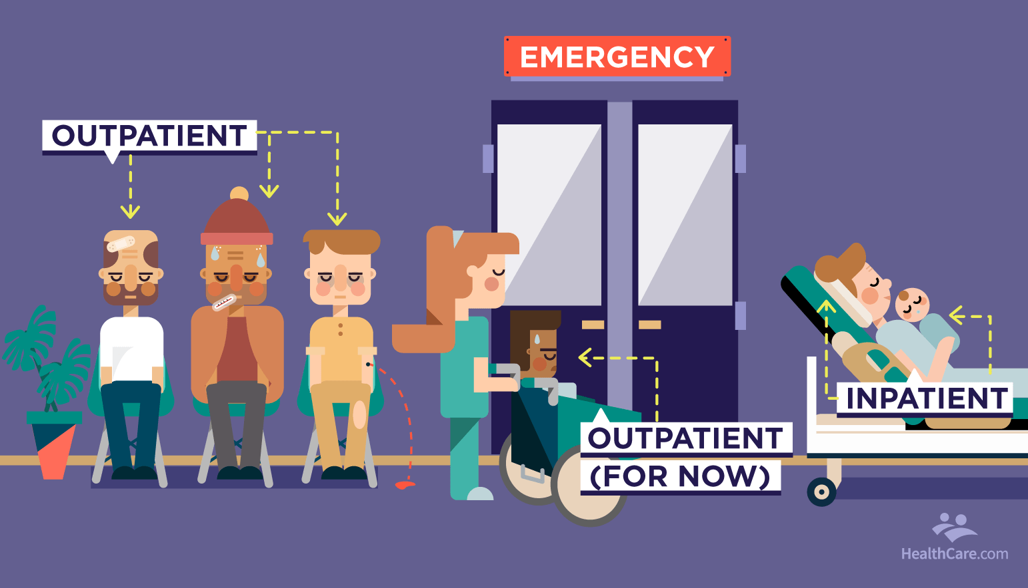
Agree
Will leave family worrying and in financial burden once hurt (对他人）
The last picture you wanna see is …
Once accident happens, hospital bill is ridiculously high
inpatient/ outpatient/ ICU/ nursing
Let alone to say how devastated the family will be if someone passed away

Slide 60

Disagree
Should be able to do what they truly love/ are keen on）
Elderly should be entitled to…
Pursue a lifestyle/ life goal
Not only they are financial independent, but also they have plenty of time to kill once retired
This remind me of an extraordinary 81 yrs old woman…

Slide 61
Disagree
Some elder people are quite fit/ able to exercise
go to the gym/ workout everyday; are capable of undertaking risks
moreover, if extreme sports have caution notice/ proper training in hand, it will be a totally different picture.

Slide 62
The Elderly 2
45
All people should be required to stop working and retire by 65. Do you agree or disagree? Why?
2017.05.06 Task2
Preparation time: 15s
Answer time: 45s

Slide 63
Agree
People over 65 cannot keep up with their job（对自己 ）
身体上：
Body is shutting down/ low metabolisms/ are more prone to feeling fatigue and exhausted
Can’t finish work on time/ before deadline/ work efficiency dropped comparing to youth
精神上：
More vulnerable/ harder to take criticism (potentially)

Slide 64
Agree
Unfair to the company and to other employees in some extent（对他人 ）
Opportunity cost is high
Fewer job opportunity/ narrow market/ higher unemployment rate
Be preoccupied with sth…
Real estate pressure/ car/ mortgage pressure

Slide 65
Disagree
Should retire as you want to
Shouldn’t be forced to retire at the ripe age of 65
Still have a lot to give/ offer, a lot left in the tank
If age reaches 70, maybe we can hang it up

Slide 66
Disagree
Should retire depending on the description of the job
Office work requires mental capabilities/ decrease with age / take exam to determine if they can still perform with past excellence in the office
Routine work/ GCP involved/ get used to/ be accustomed to …
Take bus driving as an example…

Slide 67
TASK 1 题型
1
PEOPLE & RELATIONSHIP
2
STUDY & JOB
3
LIFE EXPERIENCE & ACTIVITIES
TECHNOLOGY & SOCIETY
4

Slide 68


STUDY & JOB 学业工作题
45

Slide 69
Do you agree or disagree with the statement: Students should not be allowed to record lectures in class?
Task2 2018.1.28
What do you think about home schooling?
Task2 2018.1.06
Someone choose to work in a small company or a organization with a few workers. Others prefer to work in a large company with thousands of employees. Which do you prefer and why ?
Task2 2017.1.14

Slide 70
STUDY & JOB 题型
1
SCHOOL RULES
SCHOOL EDUCATION
2
3
JOB AND CAREER

Slide 71
SCHOOL RULES
45
Talk about the advantages and disadvantages of university allowing students to eat and drink during the class.
2016.10.29 Task2
Preparation time: 15s
Answer time: 45s

Slide 72
School Rules 1
45
Talk about the advantages and disadvantages of university allowing students to eat and drink during the class.
2017.05.06 Task2
Preparation time: 15s
Answer time: 45s

Slide 73
Pro
Get energy, stay hydrated
Too hungry to concentrate/ focus on the class, low concentration rate
Food is the fuel for study, bring the learning efficiency to the next level
Class starts rather early, not enough time for students to munch on food/have a proper meal, no nuitrition

Slide 74
Pro
Courtesy of freedom/ act of free-spirit
Students feel more comfortable in learning and expression their opinions towards others/ good and relaxed vibe & atmpsphere
Motivate students to even learn better

Slide 75
Con
Bad hygiene/ sanitation/ unhygienic
Food with strong odor smells/ is smelly; upsetting & disturbing others
Caan cause and spread diseases such as diarrhea

Slide 76
Con
Disturb the class/ learning
Hard to concentrate with loud noise around( chewing, slurpping, nibbling, crinkling)
Can cause and spread diseases such as diarrhea

Slide 77
School Rules 2
45
Do you agree or disagree with the following statement? Students should be allowed to take additional courses to graduate as soon as possible.
2016.06.18 Task2
Preparation time: 15s
Answer time: 45s

Slide 78
Agree
Save plenty of money
Current tuition fee for college is hovering around $$$ /yr.
Take AP/ IB course in high school to graduate early
Financial aid/ scholarship
Start to work early/ supporting family/ car/ gas/ rent/ mortgage

Slide 79
Agree
Save plenty of time
Graduate early than your peers in uni/ give you a head start
More time to mature in works; learn social manners/ etiquettes
Be eligible for additional scholarship

Slide 80
Disagree
Less time to take advantages of the quality college times (毕业前）
Miss the wonderful time to make friends/ social/ meet ppl. with same interests
Less time to interact with the faculty /less time to conduct meaningful research on related subject/ slim chance getting a letter of recommendation
Money you save --- lowering your lifetime earnings

Slide 81
Disagree
Less time to grow and mature (毕业后）
Realize blossom and growth happened during senior yrs
Leadership skills/ confidence/ intellect
Fewer job opportunities

Slide 82
Travelling
45
Some people prefer to stay in touch with their friends and family members while travelling, others prefer not to get in touch and stay alone. Which one do you prefer and why?
2018.12.16 Task2
Preparation time: 15s
Answer time: 45s

Slide 83
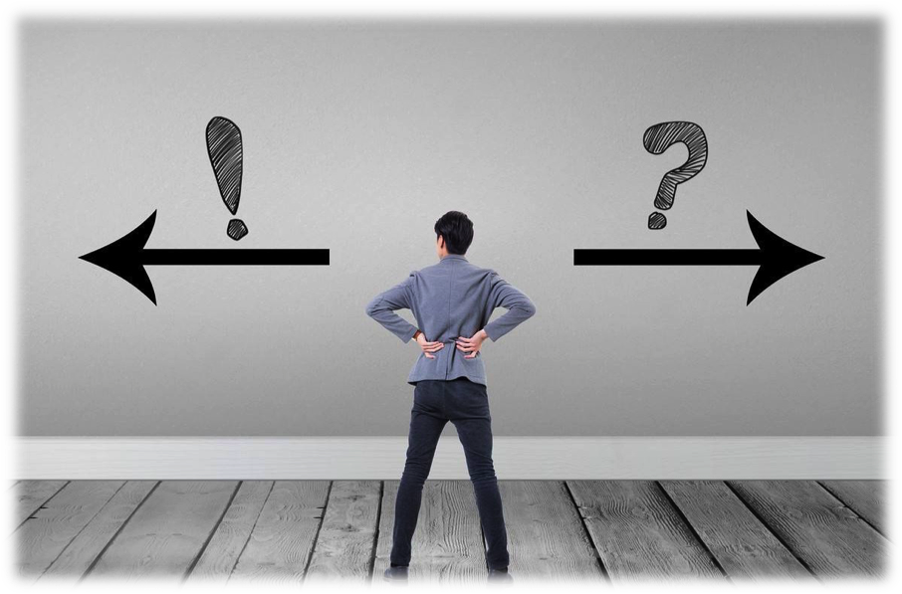
LIFE EXPERIENCE & ACTIVITIES 生活活动题
45

Slide 84
LIFE EXPERIENCE & ACTIVITIES题型
TRAVELLING
1
MEDIA COMMUNICATIONS
2
3
MONEY
4
ACTIVITIES
5
TRANSPORTATIONS

Slide 85
Travelling
45
Some people prefer to stay in touch with their friends and family members while travelling, others prefer not to get in touch and stay alone. Which one do you prefer and why?
2018.12.16 Task2
Preparation time: 15s
Answer time: 45s

Slide 86
TASK 1 万能答题思路
15
Topic
Perspective 1 （对自己）
Perspective 2 （对他人）
Perspective 3 （对双方）
Comparison (if any)
Conclusion

Slide 87

STAY IN TOUCH
I have a sharing personality/ like to talk to people
Talkative/ extrovert
Go live/ vlogging/ live video calls/ at the same time
Some moments/ Fragments of life
are too precious to share afterwards
Seize the moment

Slide 88

STAY IN TOUCH
Let them know I’m safe and sound/ keep them updated/ not worrying
… especially when I’m travelling alone/ with strangers;
If my memory serves me right, there was one time…
Hitchhiking/ trekking/ backpacking/ wilderness enclosure/ adventurous/ skeptical/undeveloped/ uncivilized/ human trafficking

Slide 89
STAY IN TOUCH
good way to bond our relationship/ close relationship
… a way to share our happiness to others
we can talk about the goods and bads/interesting stories of this trip, via video calls

Slide 90

NOT STAY IN TOUCH
Just wanna relax, have some “me” time
under lots of stress, am always busy with work/school etc.
respect the inner peace without any disturbance.

Slide 91

NOT STAY IN TOUCH
I am a private person (personality)
..being an introvert, I need my fair share of privacy
Always keep it down a notch
Seldom interact with ppl on social media

Slide 92
NOT STAY IN TOUCH
Parents can be over-worrying/ over protected sometimes
no need to make it a big deal/ make it complicated
“tell the goods, while hold the bads”

Slide 93
Travelling
45
Some people prefer to stay in touch with their friends and family members while travelling, others prefer not to get in touch and stay alone. Which one do you prefer and why?

Slide 94
Travelling
45
Some people prefer to go straight to their destination while travelling; others prefer to spend more time looking around on the way. Which do you prefer and why?
2013 9.28

Slide 95

TECHNOLOGY & SOCIETY 科技社会题
45

Slide 96
TECHNOLOGY & SOCIETY 题型
TECHNOLOGY
1
Talk about one way in which you have benefited from using the Internet. Use specific examples and details in your response.
TPO 46
TECHNOLOGY vs. STUDY
2
Some people think in the future students will have classes on the Internet instead of in buildings, but others think students will still have classes in buildings. What do you think?
MEDIA
2010 11.06 Task2
3
Do you agree or disagree that government should ban violence and dirty words in TV programs?
2017 10.14 Task2

Slide 97
Technology & Society
45
Do you agree or disagree with the following statement? With the popularity of the technology that focuses on entertainment, people read fewer books than before.
2017.01.28 Task2
Preparation time: 15s
Answer time: 45s

Slide 98
RECAP TASK 1 万能答题思路
15
Topic
Perspective 1 （对自己）
Perspective 2 （对他人）
Perspective 3 （对双方）
Comparison (if any)
Conclusion

Slide 99

AGREE
Internet is more fun/ exciting/ diverse
Subscribe to different blogger --- interesting contents such as…
Eye catching contents such as breaking news, celebrity gossip, entertainment, etc.
Pushed notification/ subscription/ major social media/ Stimulus

Slide 100
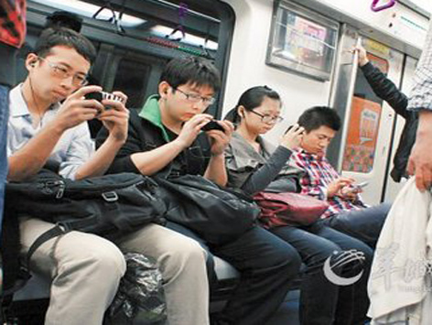
AGREE
Internet is more convenient comparing to books
Anytime anywhere/ no place restriction
No need to carry a book around, when smartphone come in handy (used to get in an internet Café)
Phubbing/phubber/ smart phone fixation
Underground system/ Shopping mall/ workplace

Slide 101

AGREE
Reading is not an efficient stress-reliever (作对比）
Most literatures are often serious/ time consuming to read
When it comes to the internet, it is a totally different scenario.
Hilarious videos/ Instant satisfaction/ pain reliever/aspirin for stress

Slide 102

DISAGREE
E books such as Kindle & Audible exist
People still read regardless, but in a more innovative way
E-reading devices and apps/ can listen to the books!

Slide 103


DISAGREE
Reading is an efficient stress-reliever
Personally speaking, when I am under the weather/ upset, I tend to choose comics/ café table books/ … with hilarious contents
Page turner/Instant satisfaction/ pain reliever/aspirin for stress/ cheer me up/ Nothing beats a good laugh

Slide 104

DISAGREE
Elderly still prefer to read books (目标具体化）
Have difficulties using high tech devices such as smartphone/ laptop
As a matter of fact, …
For instance… （举例具体化）
When
Where
What

Slide 105
15秒的迷思--------
说遍天下无敌手的万能逻辑思路
作对比
“I know avocado is not for everyone, but durian is far more obnoxious.”
目标具体化
“Lots of people in tropical area still prefer to eat durian and other fruits with smell.”
目标的多方特性 --- you/ he/she/ both party
“I like eating avocado not only because I love the smell, but also because of my dad.”
万能语料 --- 压力篇
“Being a nowadays student, I am always preoccupied with… eating my fav fruit can help me to relieve my stress, which is all I need at that moment.”

Slide 106
TECHNOLOGY & SOCIETY
45
Do you agree or disagree with the following statement? With the popularity of the technology that focuses on entertainment, people read fewer books than before.

Slide 107
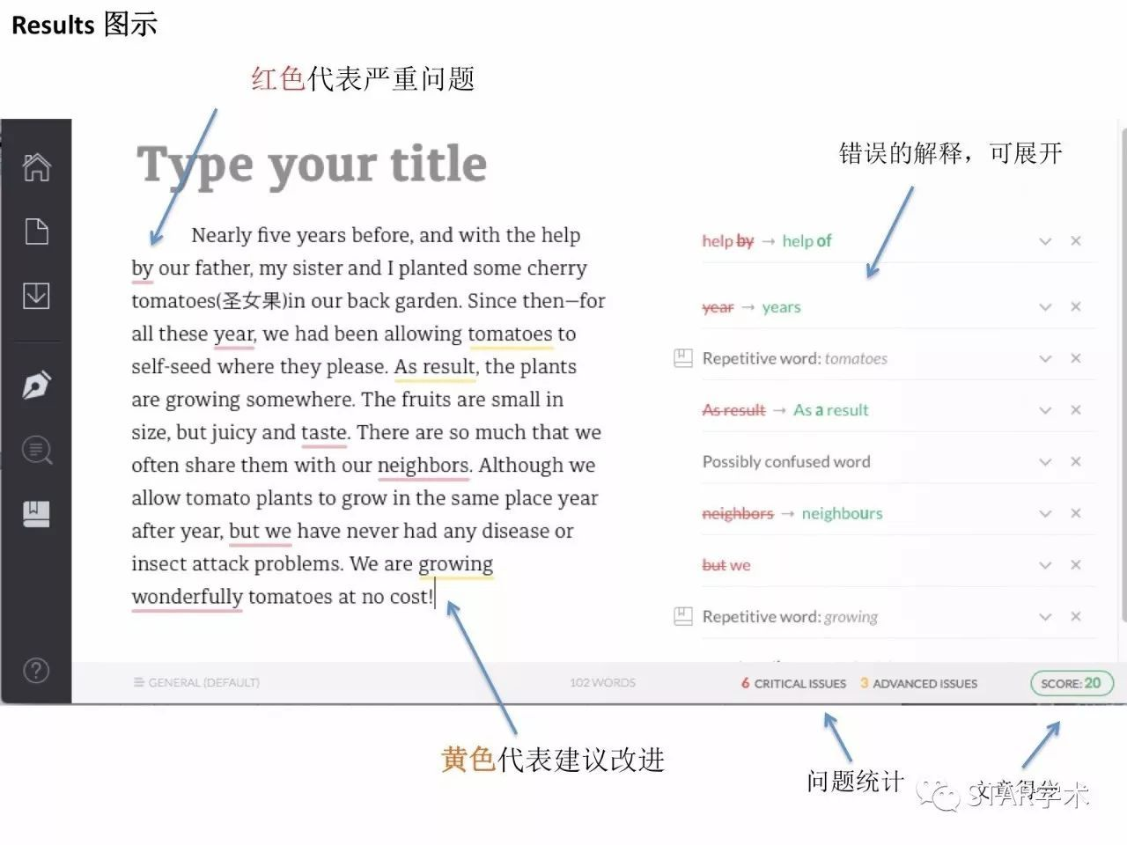
独立题 提分思路 ------- 你在哪一级？
0 - 15
15 - 20
20 - 22
答题思路 & 答题内容
（先写-复述-控时）
语法严重缺陷
（Grammarly）
发音严重问题
（纠音）
发音准确性
（纠音）
表达&内容 连贯性
（万用句型&词汇）

Slide 108
THANKS

